Slide 1
Graphs

Slide 2
GRAPHS – Definitions
A graph G = (V, E) consists of
  a set of vertices, V, and
  a set of edges, E, where each edge is a pair (v,w) s.t. v,w ∈ V
Vertices are sometimes called nodes, edges are sometimes called arcs.
If the edge pair is ordered then the graph is called a directed graph (also called digraphs) .
We also call a normal graph (which is not a directed graph) an undirected graph.
  When we say graph we mean that it is an undirected graph.

Slide 3
Graph – Definitions
Two vertices of a graph are adjacent if they are joined by an edge.
Vertex w is adjacent to v iff (v,w) ∈ E.
  In an undirected graph with edge (v, w) and hence (w,v) w is adjacent to v and v is adjacent to w.
A path between two vertices is a sequence of edges that begins at one vertex and ends at another vertex.
  i.e. w₁, w₂, …, w_{N} is a path if (w_{i}, w_{i+1}) ∈ E for 1 ≤ i ≤. N-1
A simple path passes through a vertex only once.
A cycle is a path that begins and ends at the same vertex.
A simple cycle is a cycle that does not pass through other vertices more than once.

Slide 4
Graph – An Example
1
2
A graph G (undirected)
3
4
5
The graph G= (V,E) has 5 vertices and 6 edges:
V = {1,2,3,4,5}
E = { (1,2),(1,3),(1,4),(2,5),(3,4),(4,5), (2,1),(3,1),(4,1),(5,2),(4,3),(5,4) }
Adjacent:
  1 and 2 are adjacent -- 1 is adjacent to 2 and 2 is adjacent to 1
Path:
  1,2,5 ( a simple path), 1,3,4,1,2,5 (a path but not a simple path)
Cycle:
1,3,4,1 (a simple cycle), 1,3,4,1,4,1 (cycle, but not simple cycle)

Slide 5
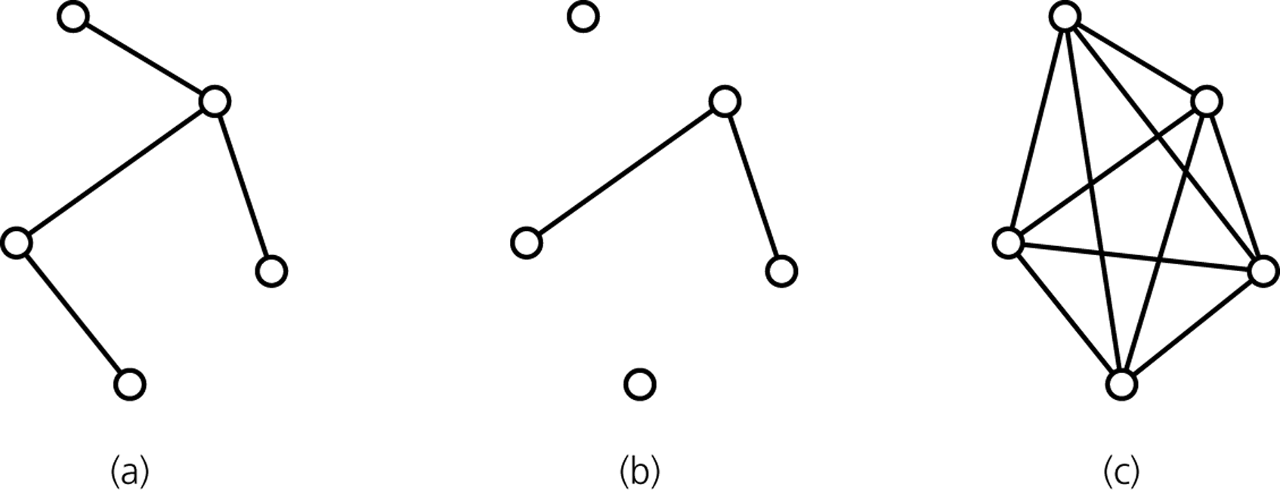
Graph -- Definitions
A connected graph has a path between each pair of distinct vertices.
A complete graph has an edge between each pair of distinct vertices.
  A complete graph is also a connected graph. But a connected graph may not be a complete graph.
connected
disconnected
complete

Slide 6
Directed Graphs
If the edge pair is ordered then the graph is called a directed graph (also called digraphs) .
Each edge in a directed graph has a direction, and each edge is called a directed edge.
Definitions given for undirected graphs apply also to directed graphs, with changes that account for direction.
Vertex w is adjacent to v iff (v,w) ∈ E.
  i.e. There is a direct edge from v to w
  w is successor of v
  v is predecessor of w
A directed path between two vertices is a sequence of directed edges that begins at one vertex and ends at another vertex.
  i.e. w₁, w₂, …, w_{N} is a path if (w_{i}, w_{i+1}) ∈ E for 1 ≤ i ≤. N-1
v
w

Slide 7
Directed Graphs
A cycle in a directed graph is a path of length at least 1 such that w₁ = w_{N}.
  This cycle is simple if the path is simple.
  For undirected graphs, the edges must be distinct
A directed acyclic graph (DAG) is a type of directed graph having no cycles.
An undirected graph is connected if there is a path from every vertex to every other vertex.
A directed graph with this property is called strongly connected.
  If a directed graph is not strongly connected, but the underlying graph (without direction to arcs) is connected then the graph is weakly connected.

Slide 8
Directed Graph – An Example
1
2
3
4
5
The graph G= (V,E) has 5 vertices and 6 edges:
V = {1,2,3,4,5}
E = { (1,2),(1,4),(2,5),(4,5),(3,1),(4,3) }
Adjacent:
  2 is adjacent to 1, but 1 is NOT adjacent to 2
Path:
  1,2,5 ( a directed path),
Cycle:
1,4,3,1 (a directed cycle),

Slide 9
Weighted Graph
We can label the edges of a graph with numeric values, the graph is called a weighted graph.
1
8
2
Weighted (Undirected) Graph
10
3
6
3
5
4
7
5
1
8
2
Weighted Directed Graph
10
3
6
3
5
4
7
5

Slide 10
Graph Implementations
The two most common implementations of a graph are:
  Adjacency Matrix
    A two dimensional array
  Adjacency List
    For each vertex we keep a list of adjacent vertices

Slide 11
Adjacency Matrix
An adjacency matrix for a graph with n vertices numbered 0,1,...,n-1 is an n by n array matrix such that matrix[i][j] is 1 (true) if there is an edge from vertex i to vertex j, and 0 (false) otherwise.
When the graph is weighted, we can let matrix[i][j] be the weight that labels the edge from vertex i to vertex j, instead of simply 1, and let matrix[i][j] equal to ∞ instead of 0 when there is no edge from vertex i to vertex j.
Adjacency matrix for an undirected graph is symmetrical.
  i.e. matrix[i][j] is equal to matrix[j][i]
Space requirement O(|V|²)
Acceptable if the graph is dense.

Slide 12
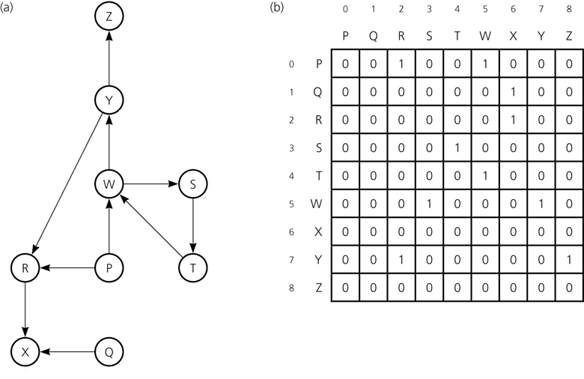
Adjacency Matrix – Example1
A directed graph
Its adjacency matrix
int G[9][9]={{0,0,1,0,0,1,0,0,0},…};

Slide 13
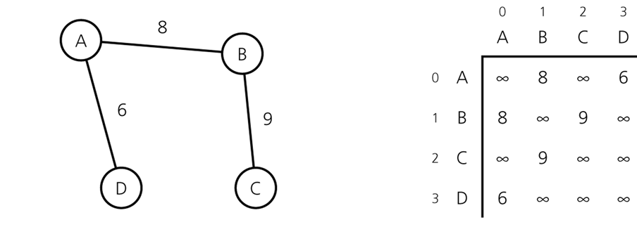
Adjacency Matrix – Example2
An Undirected Weighted Graph
Its Adjacency Matrix

Slide 14
Adjacency List
An adjacency list for a graph with n vertices consists of n linked lists. The i^{th} linked list has a node for vertex j if and only if the graph contains an edge from vertex i to vertex j.
Adjacency list is a better solution if the graph is sparse.
Space requirement is O(|E| + |V|), which is linear in the size of the graph.
In an undirected graph each edge (v,w) appears in two lists.
  Space requirement is doubled.

Slide 15
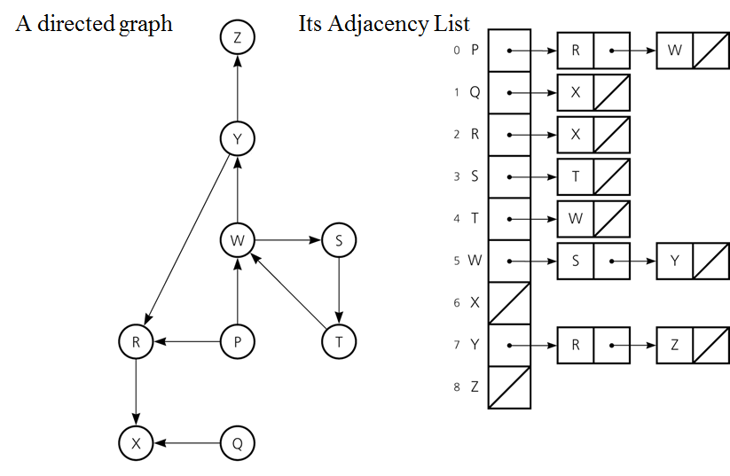
Adjacency List – Example1

Slide 16
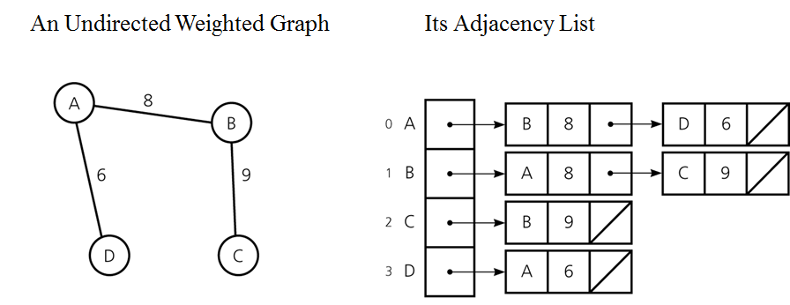
Adjacency List – Example2

Slide 17
Adjacency List Implementation:
Using Array and Linked Lists
//unweighted graph
typedef struct node{
char name;
struct node *next;
}NODE;
NODE *G[9];
//weighted graph
typedef struct node{
char name;
int weight;
struct node *next;
}NODE;
NODE *G[9];

Slide 18
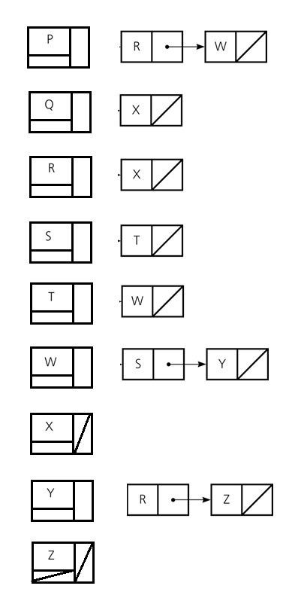
Adjacency List Implementation:
Using Only Linked Lists
//unweighted graph
typedef struct horizontal_node{
char name;
struct horizontal_node *next;
}H_NODE;
typedef struct vertical_node{
char name;
struct horizontal_node *Hnext;
struct vertical_node *Vnext;
}V_NODE;
V_NODE *G = NULL;

Slide 19
Adjacency Matrix vs Adjacency List
Two common graph operations:
  Determine whether there is an edge from vertex i to vertex j.
  Find all vertices adjacent to a given vertex i.
An adjacency matrix supports operation 1 more efficiently.
An adjacency list supports operation 2 more efficiently.
An adjacency list often requires less space than an adjacency matrix.
  Adjacency Matrix: Space requirement is O(|V|²)
  Adjacency List : Space requirement is O(|E| + |V|), which is linear in the size of the graph.
  Adjacency matrix is better if the graph is dense (too many edges)
  Adjacency list is better if the graph is sparse (few edges)

Slide 20
Graph Coloring
Graph coloring is an assignment of different colors to all neighboring vertices in a graph.
Chromatic number of a graph is the number which is equal to the minimum number of colors required to color the given graph.
Four colors theorem: any planar graph G can be colored by using at most 4 colors.
Graph coloring is used to solve many real life problems:
  Preparing exam schedule for students without any conflicts,
  Scheduling processes to processors when there exist time and processor constraints.

Slide 21
Welch-Powel Algorithm for Graph Coloring
Compute degree of each vertex on the graph, then sort the vertices w.r.t. their degrees in descending order.
Assign the first color to the first vertex in the list. Then, assign this color to other vertices which are not adjacent to each other.
Continue with the second color. Assign the second color to the vertex having the highest degree among the unassigned vertices. Then, assign this color to other vertices which are not adjacent to each other.
Repeat step 3 until all vertices are colored.

Slide 22
Example 1:
34
61
35
06
21
07
01

Slide 23
Example 1 (cont.)
34
61
Node | Degree | Color
06 | 6 | Red
01 | 3 | Blue
07 | 3 | Green
35 | 3 | Blue
21 | 2 | Green
34 | 2 | Green
61 | 1 | Blue
35
06
21
07
01

Slide 24
Example 2:
Use graph coloring to solve the problem of determining groups of exams that can be made at the same time in an exam schedule without any conflict. Assume that there are 4 students and 6 courses.
Student 1 will take exams for courses d0, d1, d4
Student 2 will take exams for courses d0, d2, d4
Student 3 will take exams for courses d2, d3, d5
Student 4 will take exams for courses d3, d4, d5
Find the list of courses whose exams can be made at the same time without any conflict between students and exams .
What is the minimum number of sessions that the exams can be performed without any conflict?

Slide 25
Example 2 (cont.)
Student 1 will take exams for courses d0, d1, d4
Student 2 will take exams for courses d0, d2, d4
Student 3 will take exams for courses d2, d3, d5
Student 4 will take exams for courses d3, d4, d5
d0
d1
Node Degree
d4 5
d2 4
d0 3
d3 3
d5 3
d1 2
Color
Red
Orange
Blue
Yellow
Blue
Orange
d5
d2
d4
d3

Slide 26
Graph Traversals
A graph-traversal algorithm starts from a vertex v, visits all of the vertices that can be reachable from the vertex v.
A graph-traversal algorithm visits all vertices if and only if the graph is connected.
A connected component is the subset of vertices visited during a traversal algorithm that begins at a given vertex.
A graph-traversal algorithm must mark each vertex during a visit and must never visit a vertex more than once.
  Thus, if a graph contains a cycle, the graph-traversal algorithm can avoid infinite loop.
We look at two graph-traversal algorithms:
  Depth-First Traversal
  Breadth-First Traversal

Slide 27
Depth-First Traversal
For a given vertex v, the depth-first traversal algorithm proceeds along a path from v as deeply into the graph as possible before backing up.
That is, after visiting a vertex v, the depth-first traversal algorithm visits (if possible) an unvisited adjacent vertex to vertex v.
The depth-first traversal algorithm does not completely specify the order in which it should visit the vertices adjacent to v.
  We may visit the vertices adjacent to v in sorted order.

Slide 28
Depth-First Traversal – Example
1
2
A depth-first traversal of the
graph starting from vertex v.
Visit a vertex, then visit a vertex
adjacent to that vertex.
If there is no unvisited vertex adjacent
to visited vertex, back up to the previous
step.
A
B
3
C
D
5
F
E
6
4

Slide 29
Recursive Depth-First Traversal Algorithm
int G[6][6]={{0,1,1,0,0,1},…};
int visited[6]={0,0,0,0,0,0};
void DFT(void){
int node;
for (node = 0; node < 6; node++){
if (visited[node] == 0)
TraverseGraph(node);
}
}
void TraverseGraph(int node){
int i;
visited[node]=1;
printf("%d\n",node);
for (i = 0; i < 6; i++){
if ((G[node][i] != 0) && (visited[i] == 0))
TraverseGraph(i);
}
}

Slide 30
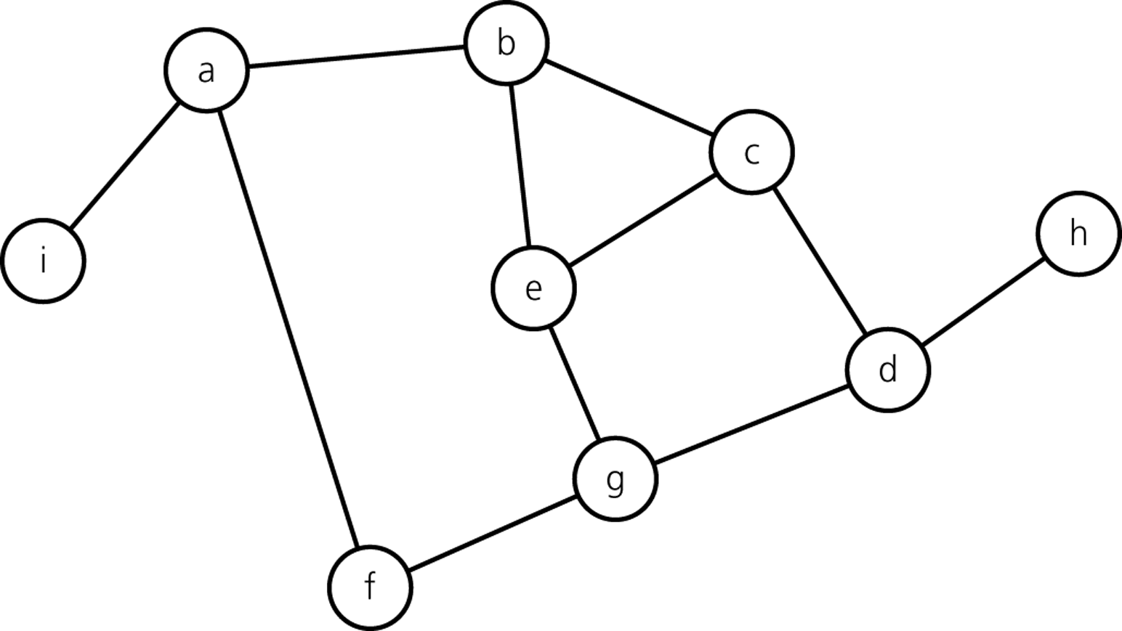
Trace of DFT – starting from vertex a
2
1
a
b
c
d
g
e
f
h
i
3
8
9
6
4
5
7

Slide 31
Breath-First Traversal
After visiting a given vertex v, the breadth-first traversal algorithm visits every vertex adjacent to v that it can before visiting any other vertex.
Continue with the first neighbor of v, and visit all of its’ neighbors.
Continue this process until all the nodes in the graph are visited.

Slide 32
Breath-First Traversal – Example
1
2
A breath-first traversal of the
graph starting from vertex A.
Visit a vertex, then visit all vertices
adjacent to that vertex.
A
B
3
C
D
5
F
E
4
6

Slide 33
Breath-First Traversal Algorithm
int visited[6]={0,0,0,0,0,0};
void BFT(void) {
int node, n, i;
for (node = 0; node < 6; node++){
if (visited[node] == 0){
enqueue(node);
while (!isEmptyQueue()) {
n = dequeue();
if (visited[n] != 0)
continue;
visited[n] = 1;
printf("%d\n",n);
for (i = 0; i < 6; i++) {
if ((G[n][i] != 0) && (visited[i] == 0))
enqueue(i);
}
}
} } }

Slide 34
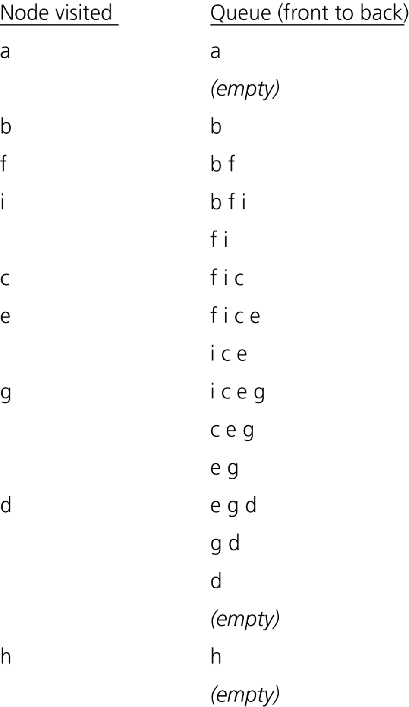
Trace of BFT – starting from vertex a
2
1
5
9
4
6
8
7
3

